Slide 1


Apache Flink® Training
Intro
Apache Flink® Training
Flink v1.3 – 20.06.2017

Slide 2
Where we’re going today
Stateful stream processing as a paradigm for continuous data
Apache Flink is a sophisticated and battle-tested stateful stream processor with a comprehensive set of features
Efficiency, management, and operational issues for state are taken very seriously

Slide 3
Stream Processing
process records one-at-a-time
...
Your Code
Long running computation, on an endless stream of input

Slide 4
Distributed Stream Processing
...
...
...
partitions input streams by some key in the data
distributes computation across multiple instances
each instance is responsible for some key range
Your Code
Your Code
Your Code

Slide 5
Stateful Stream Processing
...
...
...
qwe
var x = …
update local
variables/structures
Your Code
Your Code
Your Code
if (condition(x)) { …
}
Process

Slide 6
Stateful Stream Processing
...
...
...
qwe
var x = …
update local
variables/structures
Your Code
Your Code
Your Code
embedded local state backend
state co-partitioned with the input stream by key
if (condition(x)) { …
}
Process

Slide 7
About time ...
...
...
...
When should results be emitted?
Control for determining when the computation has fully processed all required events
It’s mostly about time. e.g. have I received all events for 3 - 4 pm?
Did event B occur within 5 minutes of event A?
Wall clock time is not correct. Event-time awareness is required.
Your Code
Your Code
Your Code

Slide 8
Traditional batch processing
t
Continuously ingesting data
Time-bounded batch files
Periodic batch jobs
...
2017-06-14 01:00am
2017-06-14 00:00am
2017-06-13 11:00pm
2017-06-13 10:00pm
Batch
jobs

Slide 9
Traditional batch processing (II)
t
Consider computing conversion metric (# of A → B per hour)
What if the conversion crossed time boundaries? → carry intermediate results to next batch
What if events come out of order? → ???
...
2017-06-14 01:00am
2017-06-14 00:00am
2017-06-13 11:00pm
2017-06-13 10:00pm
intermediate state

Slide 10
The ideal way
accumulate state
view of the “history” of the input stream
counters, in-progress windows
parameters of incrementally trained ML models, etc.
state influences the output
output depends on notion of time
outputs when results are complete
long running computation

Slide 11
The ideal way (II)
Stateful stream processing as a new paradigm to continuously process continuous data
Produce accurate results
Having results available in real-time (with low latency and high throughput) is a natural consequence of the model
Process both real-time and historic data using exactly the same application
Stateful Stream Processor that handles
consistently, robustly, and efficiently
Large
Distributed State
Time / Order / Completeness
servicing

Slide 12
Flink APIs and Runtime

Slide 13
Apache Flink Stack
Libraries
DataStream API
Stream Processing
DataSet API
Batch Processing
Runtime
Distributed Streaming Data Flow
Streaming and batch as first class citizens.

Slide 14
Programming Model
Source
Source
Computation
Computation
state
state
Transformation
Computation
state
Computation
state
Sink
Sink

Slide 15
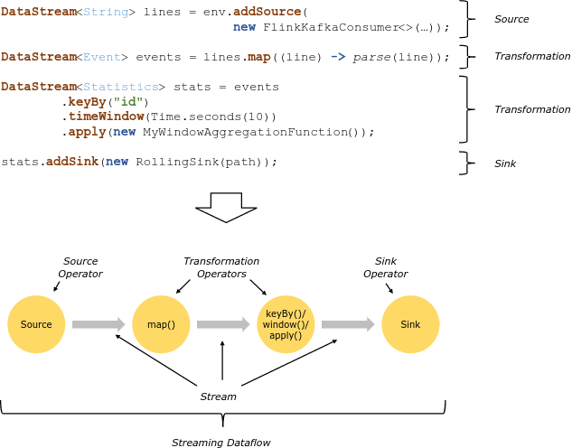

Slide 16
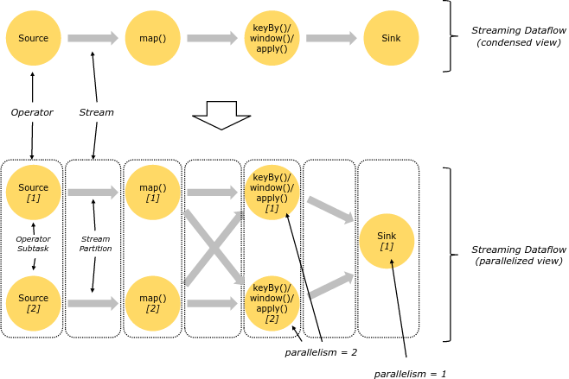
Parallelism

Slide 17
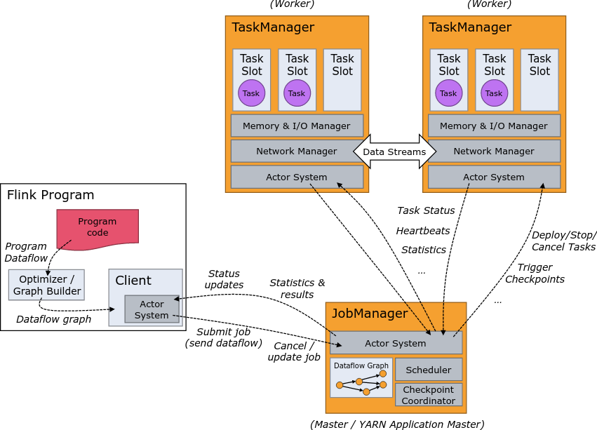
Distributed Execution

Slide 18
Levels of abstraction
high-level langauge
Stream SQL
declarative DSL
Table API (dynamic tables)
stream processing &
analytics
DataStream API (streams, windows)
low-level
(stateful stream processing)
Process Function (events, state, time)

Slide 19
Process Function
class MyFunction extends ProcessFunction[MyEvent, Result] {
// declare state to use in the program
lazy val state: ValueState[CountWithTimestamp] = getRuntimeContext().getState(…)
def processElement(event: MyEvent, ctx: Context, out: Collector[Result]): Unit = {
// work with event and state
(event, state.value) match { … }
out.collect(…) // emit events
state.update(…) // modify state
// schedule a timer callback
ctx.timerService.registerEventTimeTimer(event.timestamp + 500)
}
def onTimer(timestamp: Long, ctx: OnTimerContext, out: Collector[Result]): Unit = {
// handle callback when event-/processing- time instant is reached
}
}

Slide 20
Data Stream API
val lines: DataStream[String] = env.addSource( new FlinkKafkaConsumer10<>(…))
val events: DataStream[Event] = lines.map((line) => parse(line))
val stats: DataStream[Statistic] = stream
.keyBy("sensor")
.timeWindow(Time.seconds(5))
.sum(new MyAggregationFunction())
stats.addSink(new RollingSink(path))

Slide 21
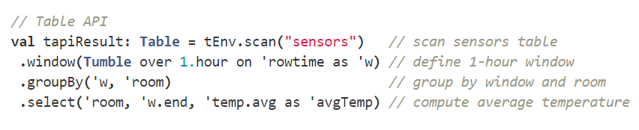
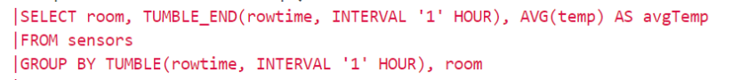
Table API & Stream SQL

Slide 22
Deployment Options

Slide 23

Local Execution
Starts local Flink cluster
All processes run in the same JVM
Behaves just like a regular Cluster
Local cluster can be started in your IDE!
Very useful for developing and debugging
Job Manager
Task Manager
Task Manager
Task Manager
Task Manager
JVM

Slide 24
Remote Execution
Job Manager
Client
Submit job
Submit a Job to a remotely running cluster
Monitor the status of a job
Task Manager
Task Manager
Task Manager
Task Manager
Cluster

Slide 25

YARN Job Mode
Brings up a Flink cluster in YARN to run a single job
Better isolation than session mode
Resource Manager
Node Manager
Node Manager
Job Manager
Task Manager
Node Manager
Node Manager
Task Manager
Other Application
Client
YARN Cluster

Slide 26
YARN Session Mode
Starts a Flink cluster in YARN containers
Multi-user scenario
Resource sharing
Easy to setup
Resource Manager
Node Manager
Node Manager
Job Manager
Task Manager
Node Manager
Node Manager
Task Manager
Other Application
Client
YARN Cluster

Slide 27
Other Deployment Options
Apache Mesos
Either with or without DC/OS
Amazon Elastic MapReduce
Available in EMR 5.1.0
Google Compute Engine
Available via bdutil
Docker / Kubernetes

Slide 28
Flink in the real world

Slide 29
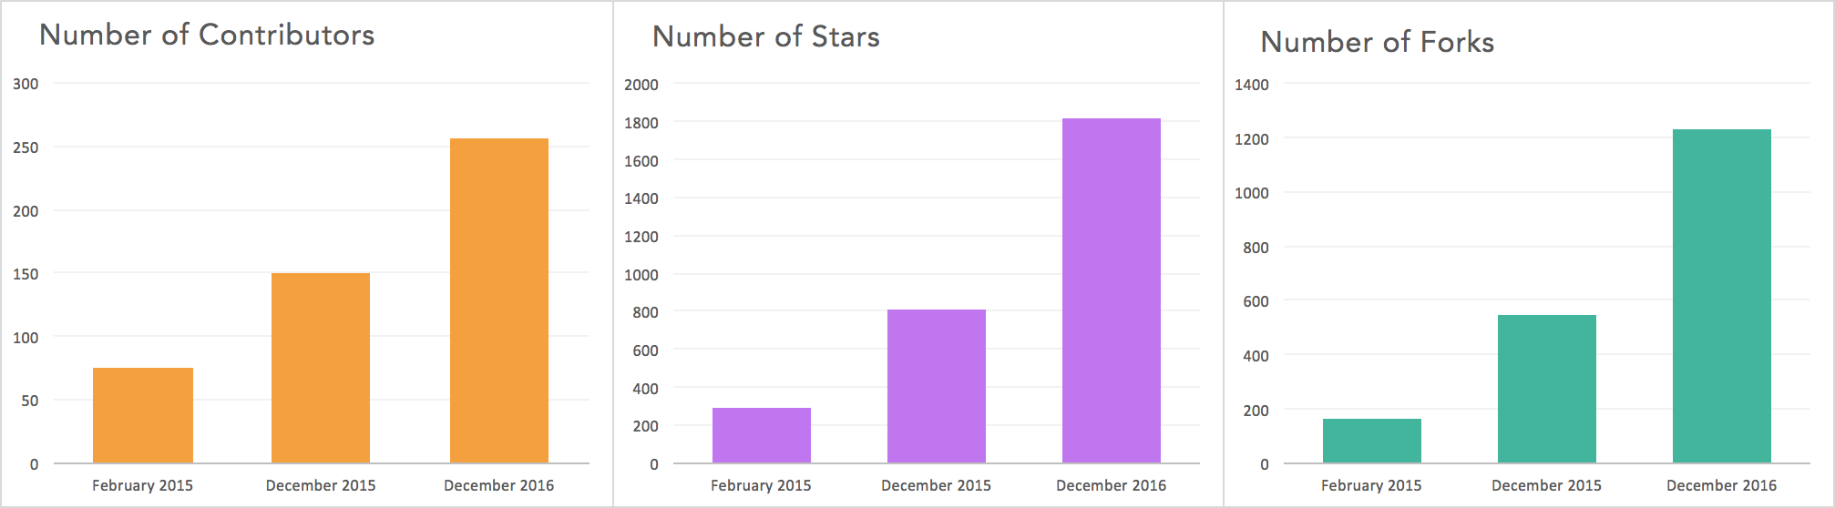
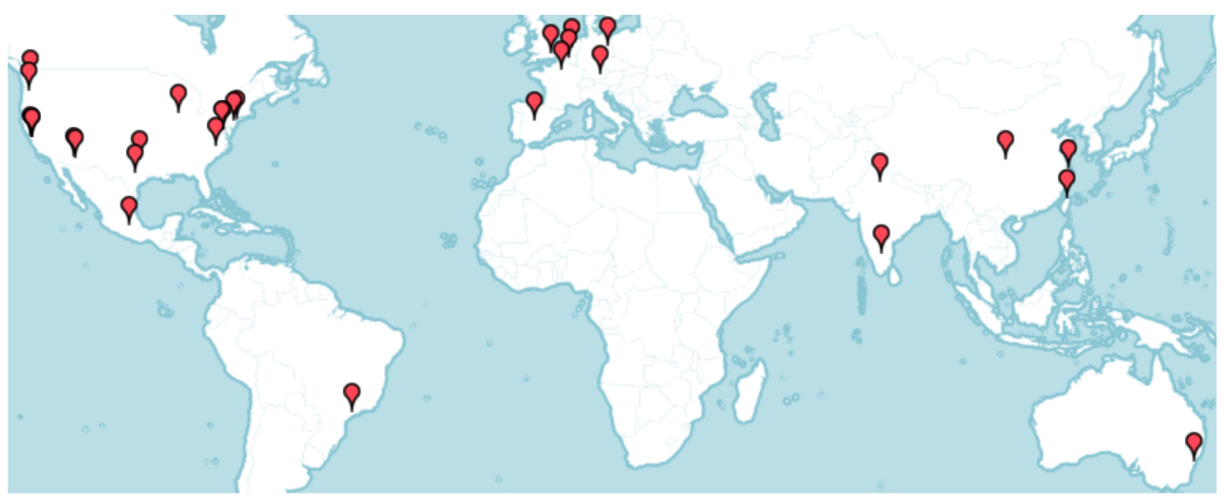
Flink community
Github
41 meetups
16,544 members

Slide 30




Powered by Flink
Zalando, one of the largest ecommerce companies in Europe, uses Flink for real-time business process monitoring.
King, the creators of Candy Crush Saga, uses Flink to provide data science teams with real-time analytics.
Alibaba, the world's largest retailer, built a Flink-based system (Blink) to optimize search rankings in real time.
Bouygues Telecom uses Flink for real-time event processing over billions of Kafka messages per day.
See more at flink.apache.org/poweredby.html

Slide 31


Slide 32



Largest job has > 20 operators, runs on > 5000 vCores in 1000-node cluster, processes millions of events per second
Complex jobs of > 30 operators running 24/7, processing 30 billion events daily, maintaining state of 100s of GB with exactly-once guarantees
30 Flink applications in production for more than one year. 10 billion events (2TB) processed daily

Slide 33
What is being built with Flink?
First wave for streaming was lambda architecture
Aid batch systems to be more real-time
Second wave was analytics (real time and lag-time)
Based on distributed collections, functions, and windows
The next wave is much broader:
A new architecture for event-driven applications

Slide 34



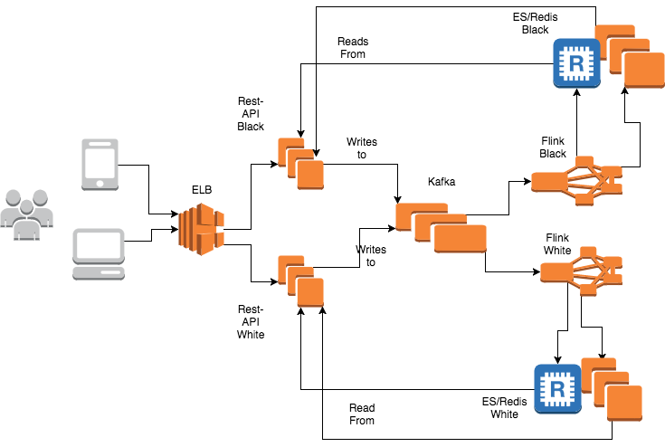


@
Complete social network implemented using event sourcing and CQRS (Command Query Responsibility Segregation)

Slide 35























Flink Forward 2016

Slide 36
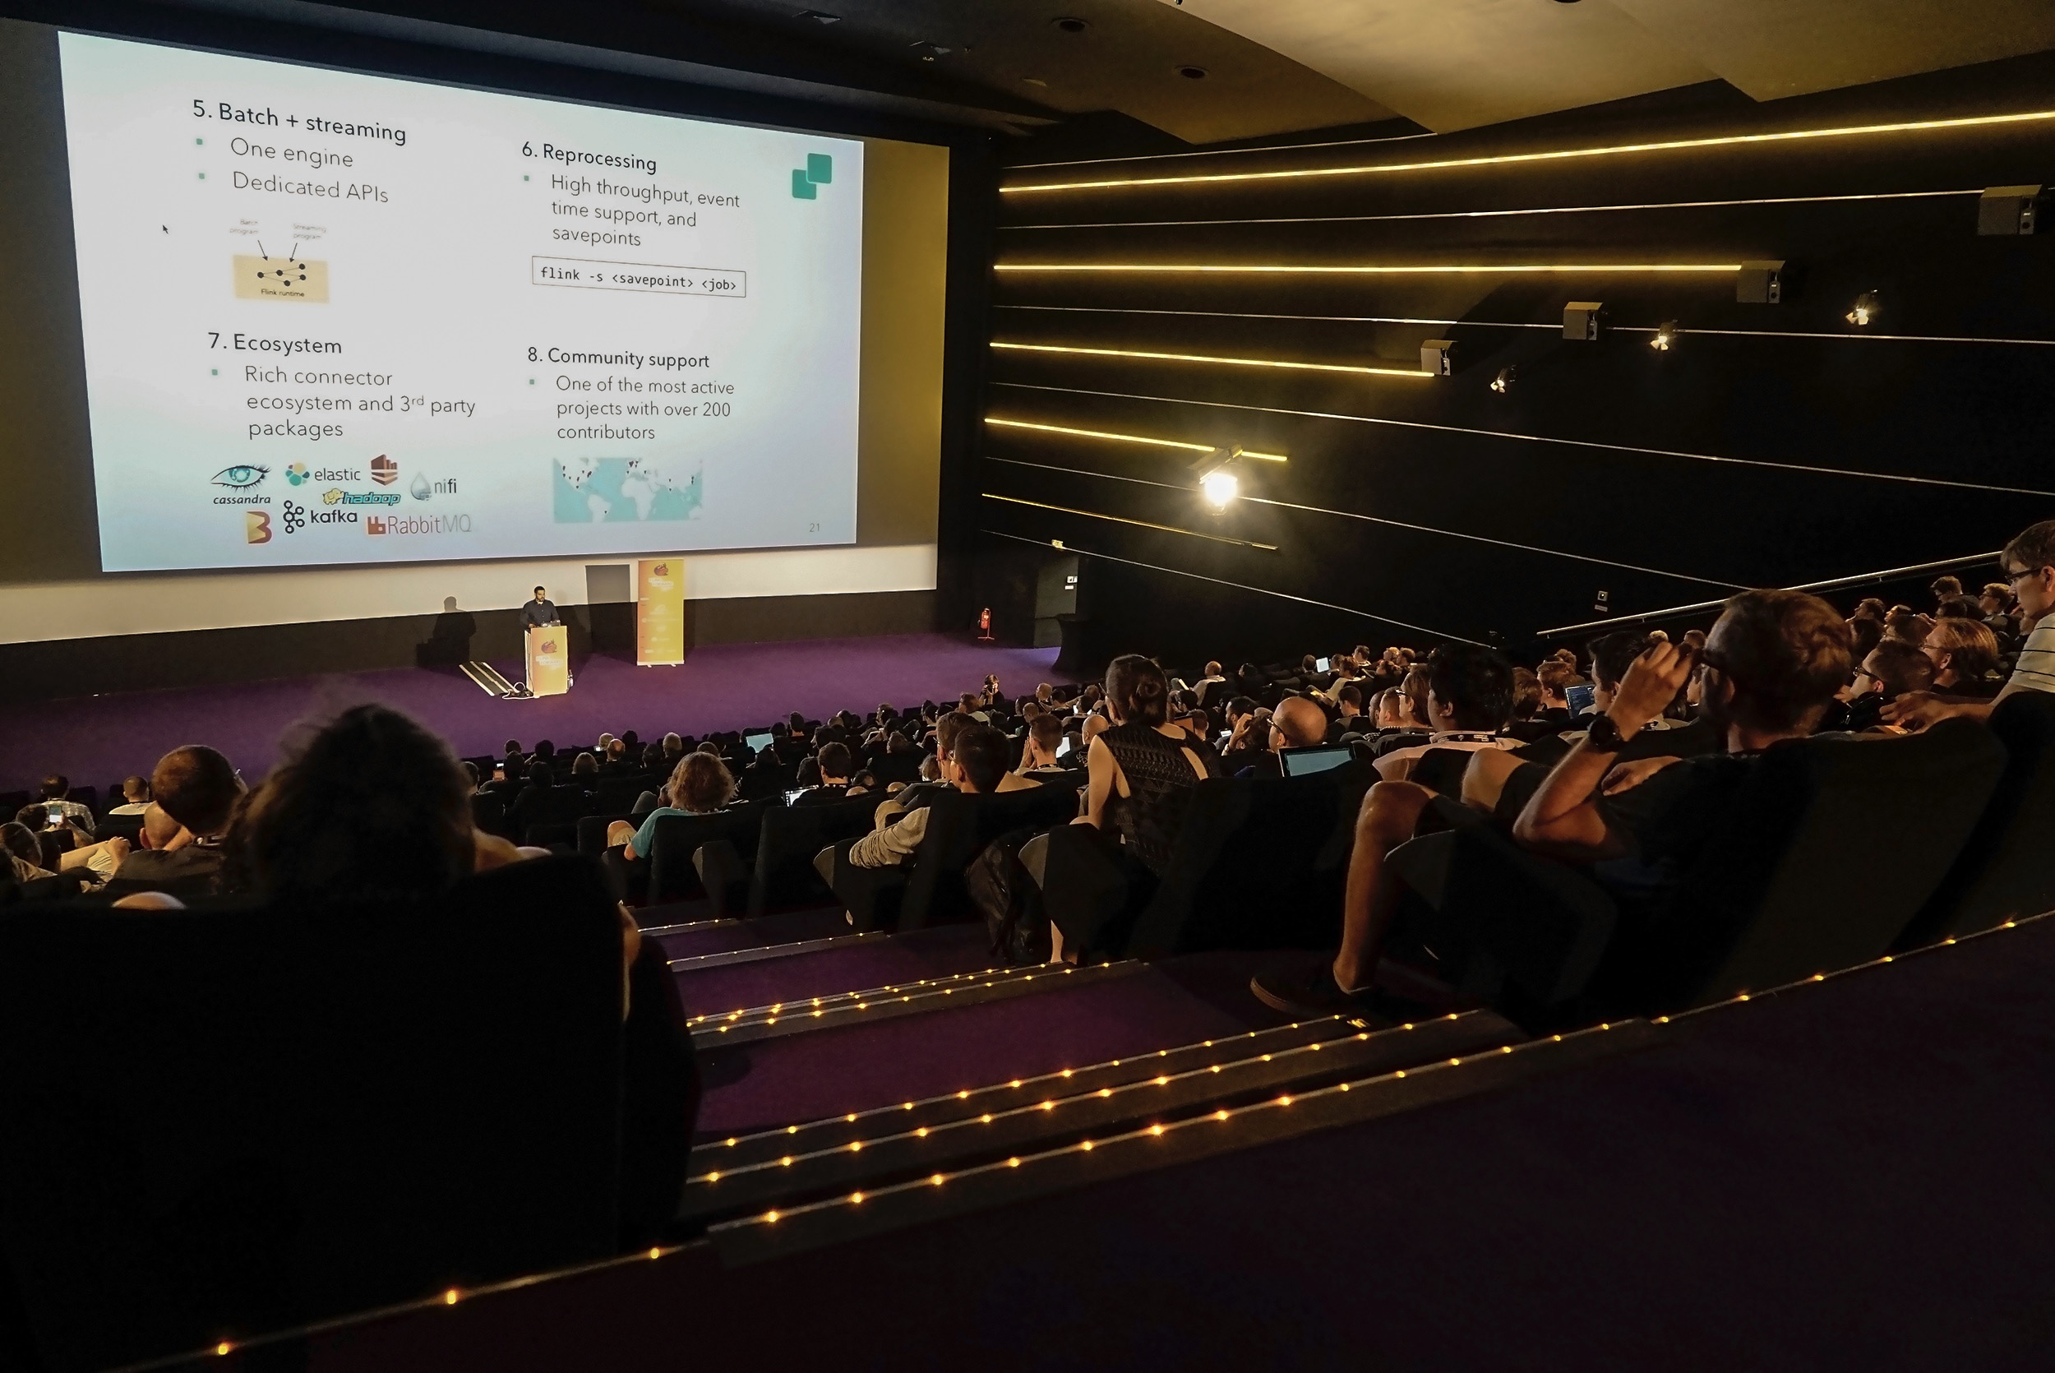
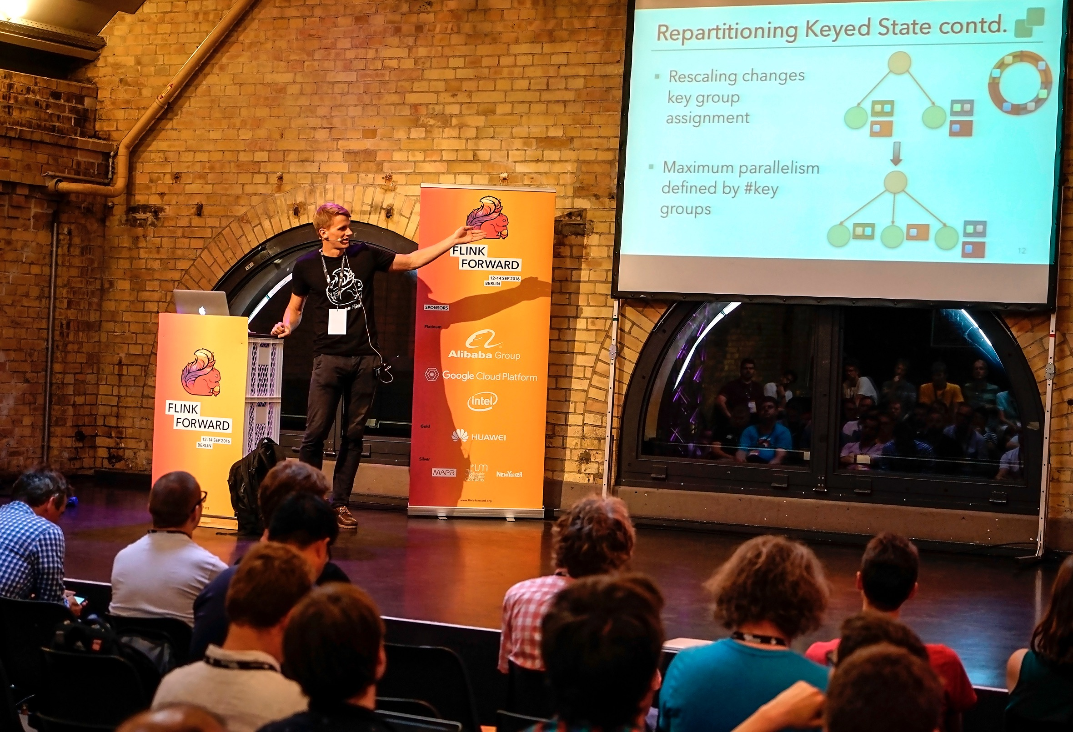
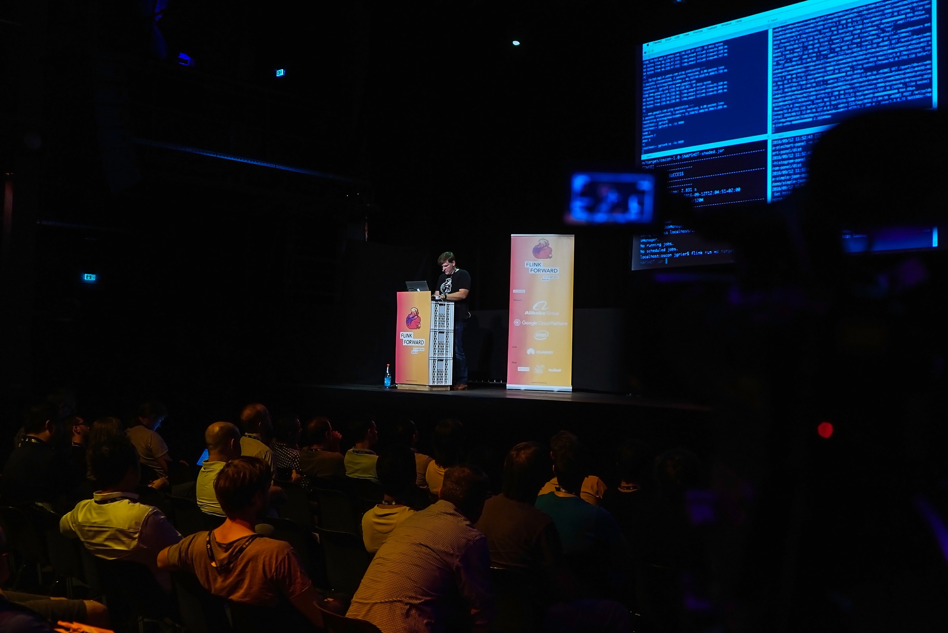
Flink Forward 2017
San Francisco
Berlin
10-11 April 2017
The first Flink Forward event outside of Berlin
Talks are online at sf.flink-forward.org/
11-13 September 2017
Over 350 attendees last year
Registration opening soon!

Slide 37
http://dataartisans.github.io/flink-training/

